Slide 1
The Coal
Coal is a fossil fuel formed from dead plant matter over millions of years due to heat and pressure.
How is Coal formed?
Over millions of years, coal is formed through different biological and geological processes on dead and decaying plant matter.
Coal mainly contains carbon. The process of conversion of dead vegetation into coal is called carbonisation.
Coal comes from a coal mine.

Slide 2
The Coal
The composition of coal
Coal consists of hydrogen, carbon and oxygen and sulphur (small amount).
Coal mining
Coal is extracted from the ground with a process called mining. Coal Mining can be of two types:

Slide 3
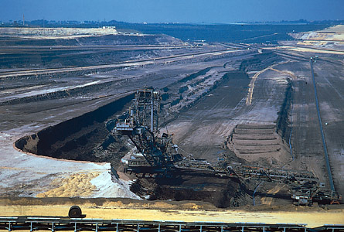
Opencast Mining: Mining in which coal is extracted from near the earth’s surface

Slide 4
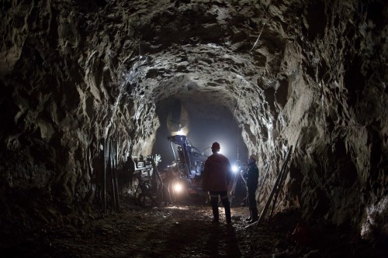
Underground Mining: Mining in which coal is extracted from deep inside the earth’s crust

Slide 5
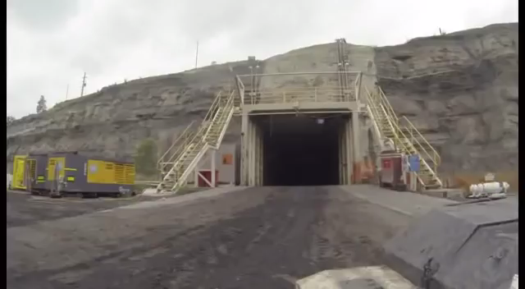
Underground Mining

Slide 6
Different Types Coal
As coal gets older, the carbon content in it is higher. When coal is burnt, it mainly produces carbon dioxide gas.

Slide 7
Uses of Coal
Used as fuel to cook food.
Used in thermal power plants to produce electricity.
Used as fuel in various industries.
Once used as fuel to run steam-powered railway engines.
When processed, coal yields coke, coal tar and coal gas which in turn is used by many industries.

